Slide 1
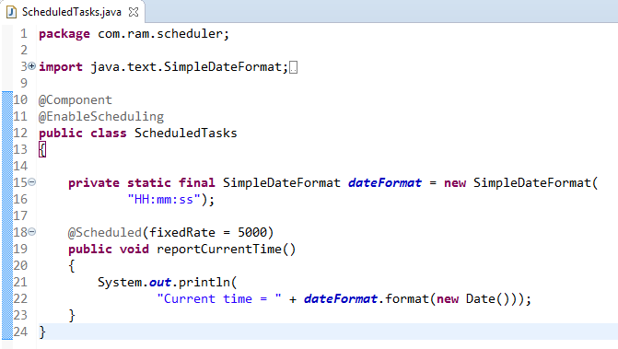
Scheduling Tasks
@EnableScheduling ensures that a background task executor is created. Without it, nothing gets scheduled.
The Scheduled annotation defines when a particular method runs.
NOTE: This example uses fixedRate, which specifies the interval between method invocations measured from the start time of each invocation.

Slide 2
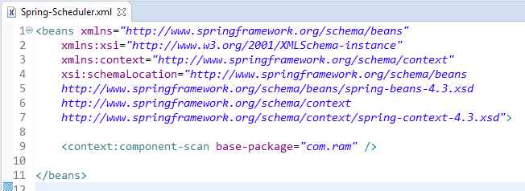
Scheduling Tasks

Slide 3
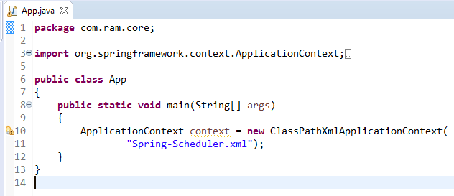
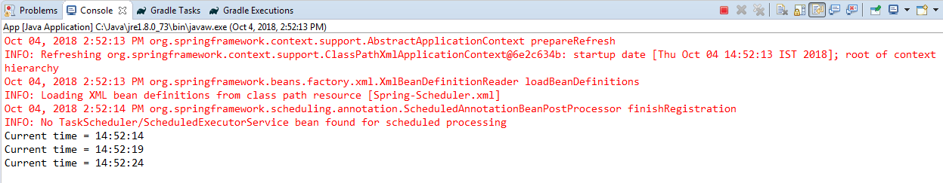
Scheduling Tasks

